Slide 1
From Experiment to Insight: A Comparative Study of Storage Approaches for Large-Scale Synchrotron and Neutron Scattering Data on AWS
Benchmarking HDF5/HSDS, Zarr, TileDB, and ROOT/TTree for Random Single-Frame Reads and Full Sequential Scans
Casper Ove Kristiansson (casperkr@kth.se)
Master's Programme in Computer Science, KTH EECS, DA231X
Supervisors: Sebastian Dalleiger, Ahmet Bahadir Yildiz
Examiner: Panagiotis Papadimitratos
1
Notes:
Finish by: 0:50
Thank you so much
My name is…
Presenting my thesis with the title
From Experiment to Insight: A Comparative Study of Storage Approaches for Large-Scale Synchrotron and Neutron Scattering Data on AWS
In short that is Benchmarking HDF5 via HSDS, Zarr, TileDB, and ROOT/TTree using two different access patterns; Random Single-Frame Reads and Full Sequential Scans with different compression algorithms
The main theme will be that the right storage choice depends on the access pattern

Slide 2
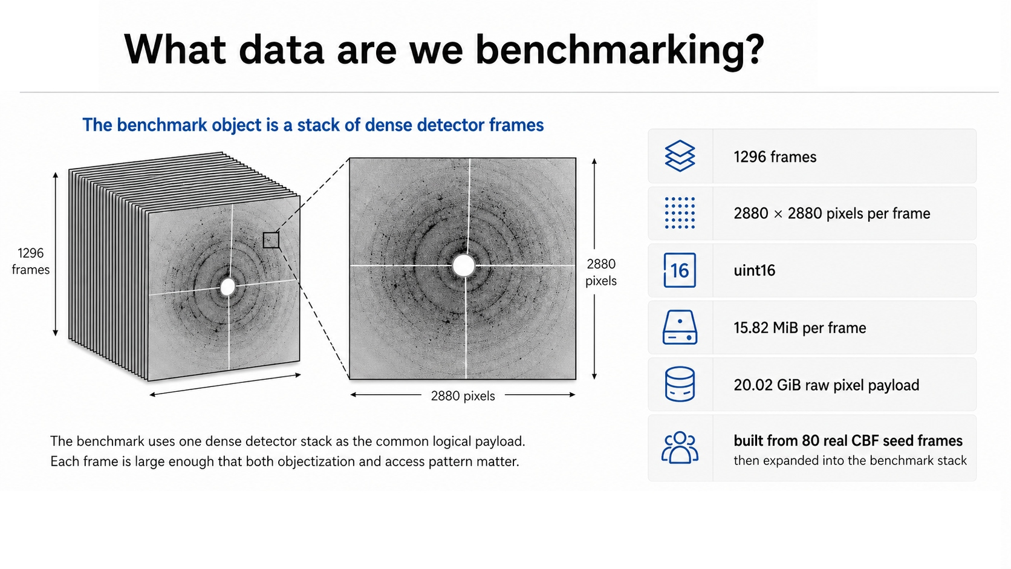
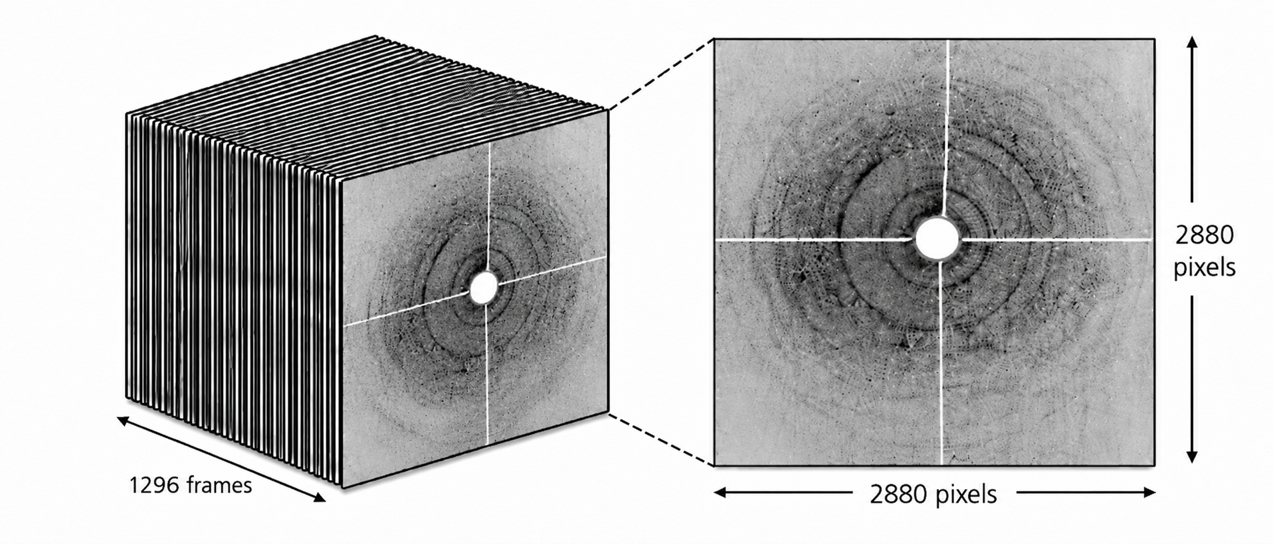
2
Notes:
Length: 1:45, Finish by: 2:35
- What are we benchmarking?
- In this thesis, the data comes from beamline-style synchrotron or neutron experiment
- What this in practice means is that a beamline instrument sends an X-ray or neutron beam through optics onto a sample
- The sample is positioned on a stage, and a high-speed detector records the intensity after the beam interacts with the material.
- Each detector exposure becomes one 2D image: intensity values over x/y detector pixels.
Define the benchmark data: - The benchmark object is a stack of dense detector frames. - There are 1296 frames. - Each frame is 2880 by 2880 pixels. - The datatype is uint16. - A single frame is about 15.82 MiB. - The raw logical payload is about 20.02 GiB. Source of the dataset: - The benchmark stack was built from 80 real CBF seed frames. - These were synthetically expanded into the benchmark dataset. - This gives a controlled dataset while preserving detector-frame structure. Transition: - The key issue is that this same dataset is used in two different ways.

Slide 3
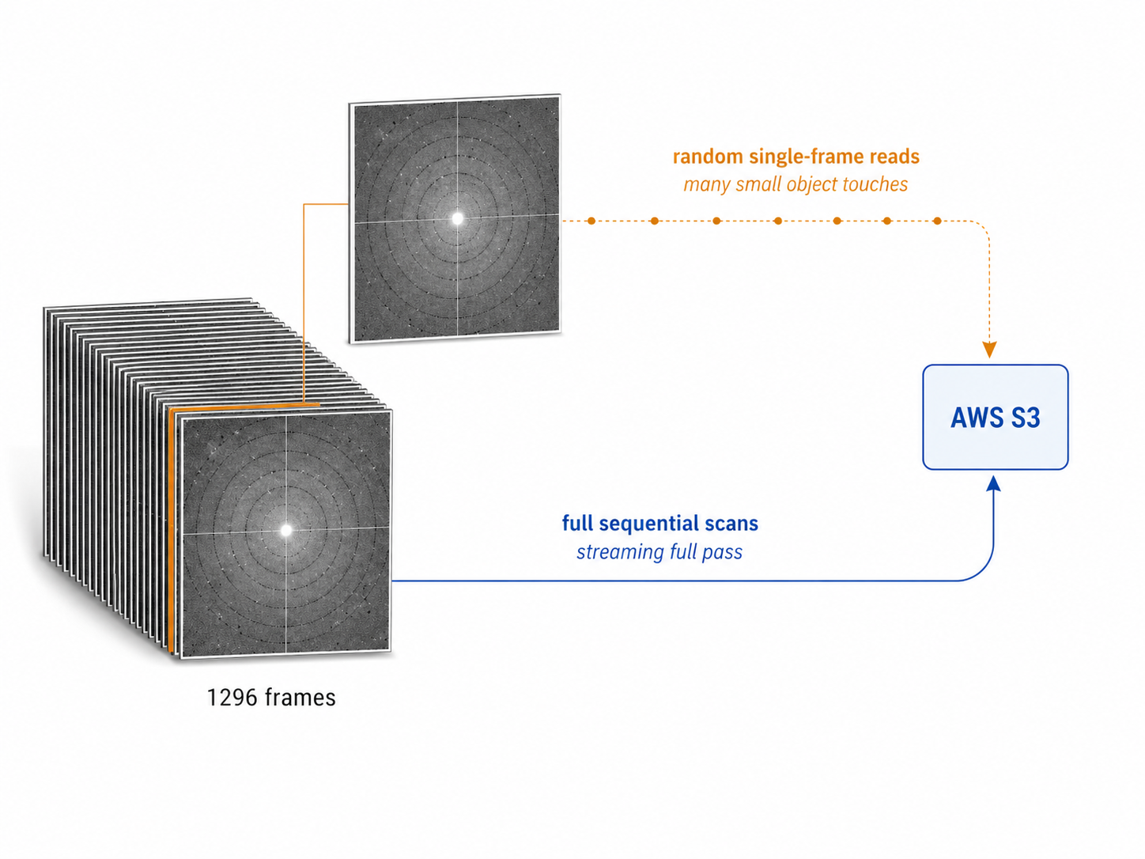
The storage problem is one dataset with two competing access patterns
One dataset.
Two competing access patterns.
Layout changes latency and request fan-out.
The same logical dataset creates different object-store behavior.
3
Notes:
Length 1:30, Finish by 4:05
Main framing: - With this data, in that builds the framing of the thesis: one dataset, two competing access patterns. - The logical dataset is the same. - But the storage system sees very different behavior depending on how it is read. single-frame: - The first access pattern is random single-frame reads. - This represents interactive inspection. - A scientist may want to quickly inspect one frame or slice without reading the whole dataset. - This is a latency-first workload. Full sequential: - The second access pattern is a full sequential scan. - This represents reconstruction, reprocessing, or analysis pipelines. - Here the goal is to read the whole dataset efficiently. - This is a scan-time or throughput-first workload. Why the conflict matters: - A layout optimized for one frame may not be optimal for full scans. - A layout that streams well may still have bad single-frame latency. - This is why I do not ask for one universal best format. Thesis logic: - Instead, I compare backend + compression algorithm combinations against these two explicit workloads. Transition: - This leads to the research question.

Slide 4


Research question and decision target
Which backend + codec combinations best support random single-frame reads and full sequential scans on AWS S3?
Random single-frame reads
Full sequential scans
Interactive inspection of individual detector frames
End-to-end passes over the same logical dataset
Decision target: choose a storage + codec strategy for this bounded AWS/S3 setup.
4
Notes:
Length 1:10 Finish by 5:15
Research question: - Research question: Which backend + codec combinations best support random single-frame reads and full sequential scans on AWS S3? Define the two sides: - Random single-frame reads represent interactive inspection. - Full sequential scans represent end-to-end processing over the same logical dataset. Explain backend + codec: - The backend is the storage layout and access implementation. - The codec is the compression choice: - gzip, - lz4, - Zstandard, zstd.
- The combination matters because how layout and compression interacts. Decision target: - The goal is to choose a storage + codec strategy for this bounded AWS/S3 setup. - So the output is a decision guide
Scope boundary: - Scoped to AWS and no other cloud provider and focused on this dataset
Transition: - Next, we can go into detail why the four timed backends can behave differently even on the same data.

Slide 5
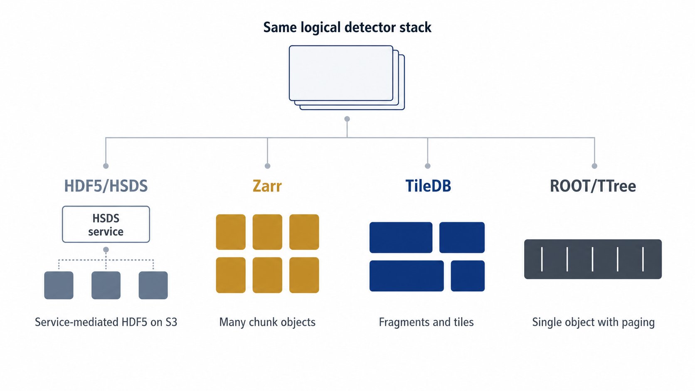
The same detector stack becomes four different S3-facing layouts
5
Notes:
Length 1:40, Finish by 6:55
Key idea: - The same logical detector stack is mapped to S3 in four different ways. - This physical layout controls: - objectization, - request pattern, - metadata behavior, - possible parallelism. HDF5/HSDS: - HDF5 via HSDS layer which preservers the HDF5 data model. - But access goes through an HSDS service layer. - That gives compatibility. - But it can add REST and metadata overhead. Zarr: - Zarr is a direct chunk-based object-store layout. - In this benchmark, chunks are frame-aligned. - So a single-frame read maps naturally to a chunk object. TileDB: - TileDB uses fragments and tiles. - This is different from pure chunk-per-object storage. - The fragment layout can support longer sequential reads. - That matters for full scans. ROOT/TTree: - ROOT/TTree is the single-object contrast case. - It uses internal paging and range reads. - That can keep request count low. - But low request count does not automatically mean low latency. Transition: - Before showing results, I need to make clear what the benchmark did and did not claim.

Slide 6
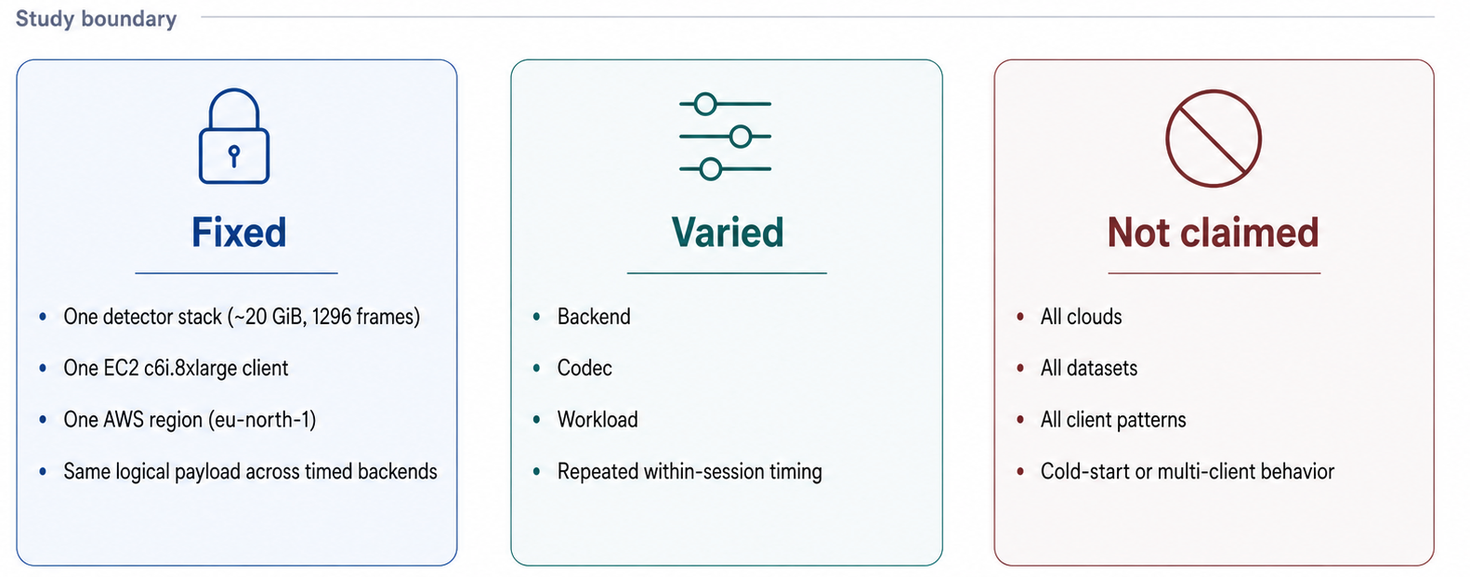
Controlled scope: what was fixed, varied, and not claimed
CloudWatch request metrics are used as context, not as direct causal proof.
6
Notes:
Length 1:20 Finish by 8:15
Why this slide matters: - Cloud benchmarks can easily overclaim. - I deliberately bounded the study to make the comparison controlled. Fixed: - One detector stack, not multiple datasets - One EC2 c6i.8xlarge client. - One AWS region: eu-north-1. - Same logical payload across the timed backends. Varied: - 4 different Backend. - 3 different Codec. - 2 different Workload. Not claimed: - Not all clouds. - Not all datasets. - Not all client patterns. - Cold-start and multi-client behavior are outside scope. CloudWatch boundary: - CloudWatch request metrics are used as context. - They help explain request behavior. - They are not treated as causal proof. Transition: - The next slide shows the actual metrics used to evaluate each cell.

Slide 7
Methods and reported metrics
GM slice latency
GM full-scan time
p95 slice latency
GETs/GiB
Stored size
central read latency
central scan completion
user-visible tail
request-intensity context
storage-footprint context
n = 50 timed repetitions per cell | warm-ups excluded | GM on log scale | dependence-robust intervals | descriptive within-session contrasts
Codec labels are aligned, but implementations remain backend-specific.
7
Notes:
Length 1:55 Finish by 10:10
Experiment matrix: - There are 4 timed backends. - There are 3 codecs. - There are 2 workloads. - That gives 24 cells. - Each cell is run 50 times
- Warm-ups are excluded. Timing scope: - The timing is captured on the client side
- It includes: - network transfer, - decompression, - client decode. - That is the performance a user or pipeline experiences. GM slice latency: - For random single-frame reads, we report Geometric Mean slice latency. - Geometric Mean is used because timing data is positive, skewed, and ratio-based. GM full-scan time: - For full scans, I report Geometric Mean to capture end to end time. p95: - p95 captures tail behavior. - This matters because interactive users feel slow tail requests. Statistical caution: - Repeated runs inside one cloud session are not fully independent, so I use moving-block bootstrap
- I also used log-scale analysis and dependence-robust intervals.
- I also checked medians and p95 sensitivity, including Harrell–Davis, as robustness checks.
- Cross-format contrasts remain descriptive and session-conditional. Codec implementation caution: - compression algorithms labels are aligned. - But implementations remain backend-specific. - So this is an implementation-level backend + codec benchmark. - It is not a pure codec-kernel benchmark. Transition: - With that method defined, I can now show the main result mapping.

Slide 8
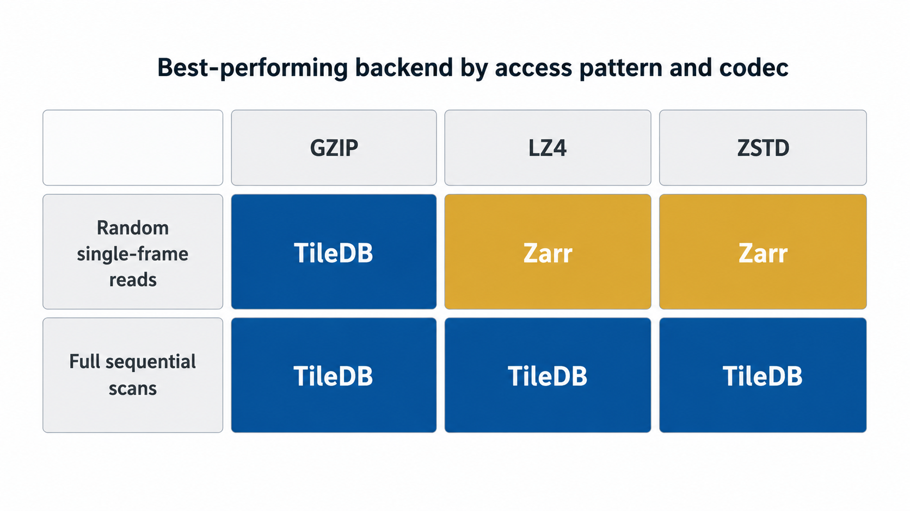
Winner matrix by workload and codec
Zarr wins two read conditions; TileDB wins all scans.
8
Notes:
Length 0:50 Finish by 11.00
Result map: - This is the main result in compact form. - Each cell shows the best-performing backend for that workload and codec. Random single-frame reads: - TileDB wins with gzip. - Zarr wins with lz4. - Zarr wins with Zstandard. Full sequential scans: - TileDB wins all of them
- This is the strongest pattern in the benchmark. Interpretation: - This does not mean one backend is universally best. - It means the best choice depends on workload. - Zarr is the stronger interactive-read choice. - TileDB is the stronger full-scan setup. Transition: - I will now unpack the two rows of this matrix, starting with random single-frame reads.

Slide 9
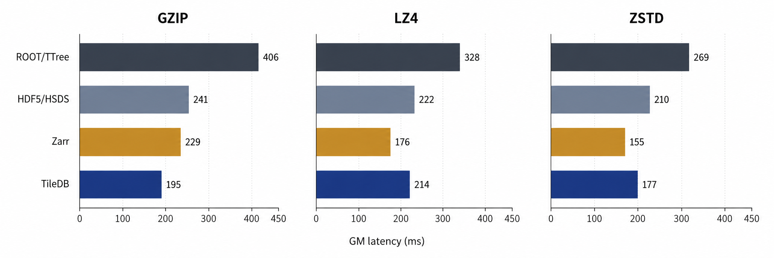
Random single-frame reads: Zarr wins overall; gzip is the exception
Exception: TileDB wins with gzip
Best overall: Zarr + zstd
Bars show GM latency; lower is better.
9
Notes:
Length 1:50 Finish by 12:50
Chart explanation: - These bars show Geometric Mean latency in milliseconds. - Lower is better. - The workload is reading one randomly selected frame out of the 1296 frames. gzip: - gzip is the exception. - TileDB is fastest at about 195 ms. - Zarr is second at about 229 ms. - HDF5/HSDS is about 241 ms. - ROOT/TTree is slowest at about 406 ms. lz4: - With lz4, Zarr wins on Geometric Mean latency at about 176 ms. - TileDB is about 214 ms. - HDF5/HSDS is about 222 ms. - ROOT/TTree is again slowest at about 328 ms. zstd: - With Zstandard, Zarr is fastest overall at about 155 ms. - TileDB is second at about 177 ms. - HDF5/HSDS is about 210 ms. - ROOT/TTree is about 269 ms. Main interpretation: - The best overall slice choice is Zarr + Zstandard. - TileDB + gzip is the important exception.
- HDF5 via HSDS comes in third - ROOT/TTree is consistently poor for frame-random reads. Transition: - The scan workload has a different winner.

Slide 10
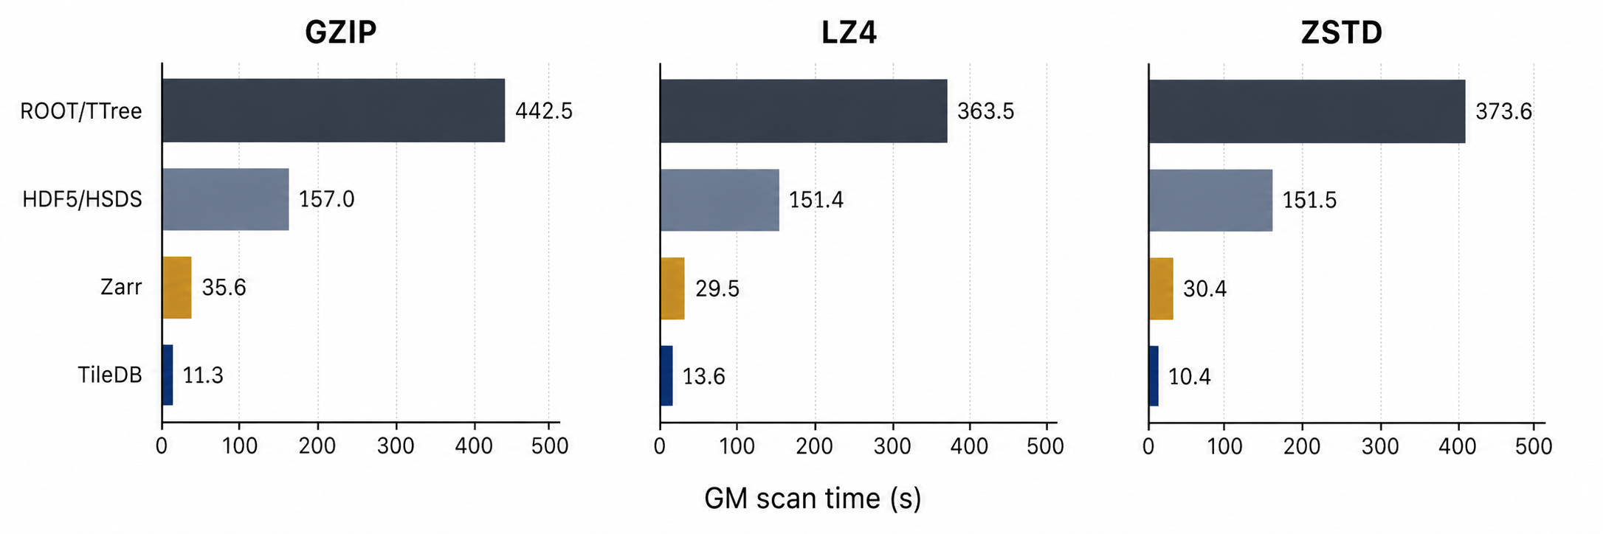
Full sequential scans: TileDB wins across every tested codec
TileDB is 2.2-3.2x faster than Zarr
Best scan time: TileDB + zstd (10.4 s)
Same logical dataset in every cell; lower is better.
10
Notes:
Length 1:40 Finish by 14:30
Chart explanation: - These bars show Geometric Mean scan time in seconds. - Lower is better. - Every backend scans the same logical dataset. Main pattern: - TileDB wins every codec. - Zarr is consistently second. - HDF5 via HSDS and ROOT/TTree are far behind. gzip: - Under gzip, TileDB scans in about 11.3 seconds. - Zarr takes about 35.6 seconds. - That makes TileDB about 3.2x faster than Zarr. lz4: - Under lz4, TileDB scans in about 13.6 seconds. - Zarr takes about 29.5 seconds. - That is about 2.2x faster. zstd: - Under Zstandard, TileDB has the best scan time: about 10.4 seconds. - Zarr takes about 30.4 seconds. - That is about 2.9x faster. Main interpretation: - For full scans, the default recommendation is TileDB + Zstandard. - TileDB + lz4 can be considered if throughput or CPU pressure dominates and the larger storage footprint is acceptable. Transition: - For interactive access, however, the center metric is not enough; tail latency also matters.

Slide 11
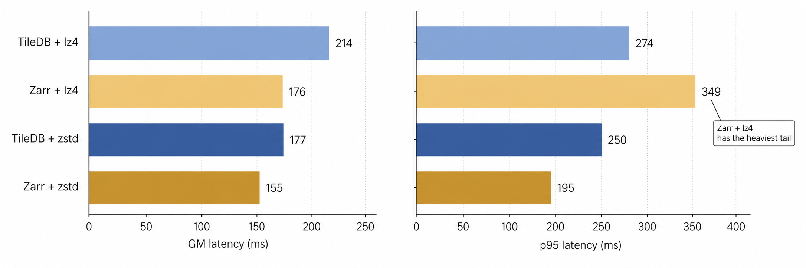
Tail behavior supports the recommendation; Zarr + lz4 is the caution
GM and p95 are shown only for Zarr and TileDB under zstd and lz4.
11
Notes:
Length 1:30 Finish by 16:00
Why p95 matters: - This slide looks at both Geometric Mean and p95. - Where Geometric Mean shows typical latency. - p95 shows slow-tail behavior. - For interactive users, p95 matters because occasional slow reads are visible and does give the user pain point Subset shown: - This focuses on the main slice candidates: Zarr and TileDB under Zstandard and lz4.
zstd: - Zarr + Zstandard has Geometric Mean about 155 ms. - Its p95 is about 195 ms. - That supports Zarr + Zstandard as the safest default for random single-frame reads. lz4: - Zarr + lz4 has the best Geometric Mean among lz4 slices: about 176 ms. - But its p95 is about 349 ms. - TileDB + lz4 has higher Geometric Mean, about 214 ms. - But TileDB + lz4 has lower p95, about 274 ms. Interpretation: - Zarr + lz4 is fast on typical latency. - But it is a caution if tail latency matters. - This is why Zstandard is the better default slice recommendation. Transition: - The next part explains why request count alone does not explain the results.

Slide 12
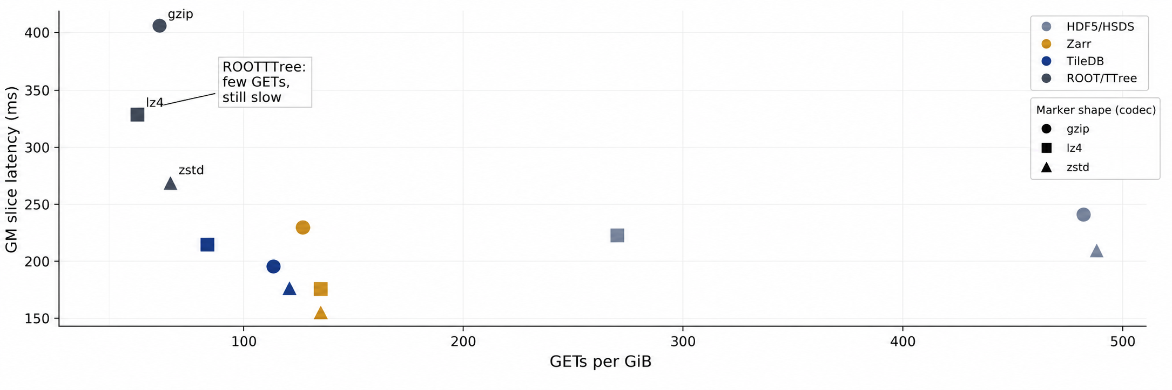
GET intensity helps explain latency; ROOT/TTree shows request count is not enough
ROOT/TTree is the counterexample: few GETs/GiB, yet poor random single-frame latency.
CloudWatch request counts are explanatory context, not direct proof of mechanism.
12
Notes:
Length 1:30 Finish by 17:30
Plot explanation: - The x-axis is GETs per GiB. - The y-axis is Geometric Mean slice latency. - Each point is a backend + compression algorithm. Main mechanism: - GET intensity helps explain performance. - But it is not sufficient. ROOT/TTree counterexample: - ROOT/TTree is the counterexample. - It has few GETs/GiB because it is a single-object layout. - But it still has poor single-frame latency. Why: - The missing factors are: - layout, - object size, - paging, - range-read behavior, - parallelism, - decode path. - ROOT/TTree minimizes request count. - But it still pays for internal paging and decode. - Zarr and TileDB expose more useful access units for these workloads. CloudWatch caveat: - CloudWatch request counts support these interpretation. - But they are context, not causal proof. - Client timing includes: - transfer, - decompression, - decode, - metadata handling, - library behavior. Transition: - This mechanism also explains the negative results.

Slide 13
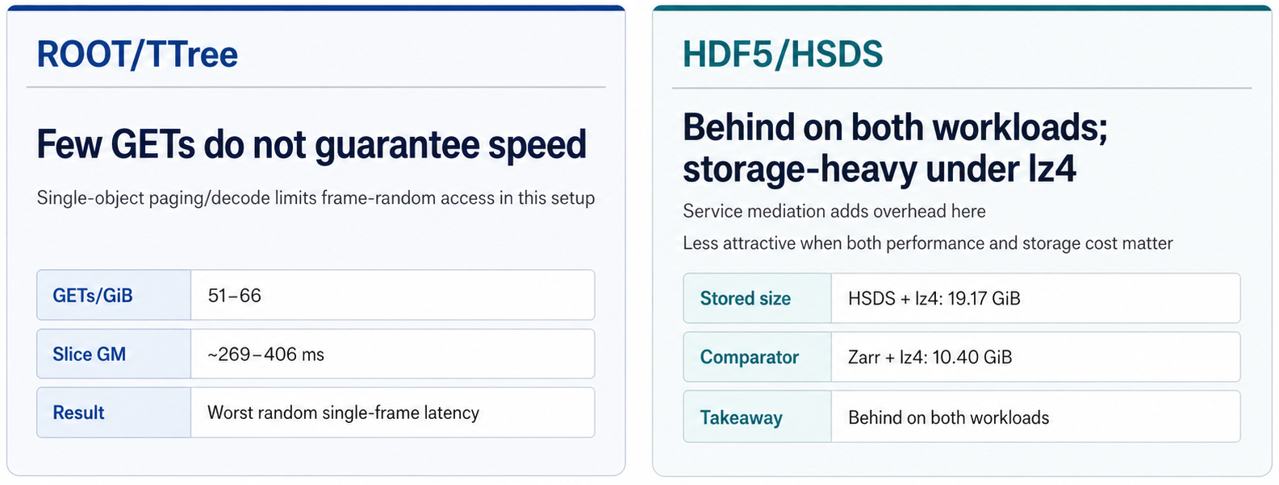
Negative results reveal structural limits in this setup
Negative results improve the decision framework by clarifying which designs to avoid for specific priorities
13
Notes:
Length 1:30 Finish by 19:00
Frame the slide: - These negative results are not just failures. - They clarify which designs to avoid for specific priorities. ROOT/TTree: - ROOT/TTree had low GETs/GiB. - But it had the worst random single-frame latency. - The reason is single-object paging and decode behavior. - The takeaway is: - few GETs do not guarantee speed. HDF5/HSDS: - HDF5 via HSDS helps preserves HDF5-style access. - But in this setup, service mediation adds overhead. - It was behind on both workloads. - The lz4 case is storage-heavy: - HSDS + lz4 stored 19.17 GiB. - Zarr + lz4 stored 10.40 GiB. - So HSDS + lz4 is unattractive when storage cost matters. Parquet, spoken briefly: - Parquet was also tested as a pilot. - The tested single-object layout produced about a 34 GiB object for a 20 GiB raw stack. - Metadata open took 3 to 4 minutes. - So it was excluded from timed runs. - This is not a claim about tuned partitioned Parquet Transition: - With the winners and negative results together, the decision guide becomes straightforward.

Slide 14
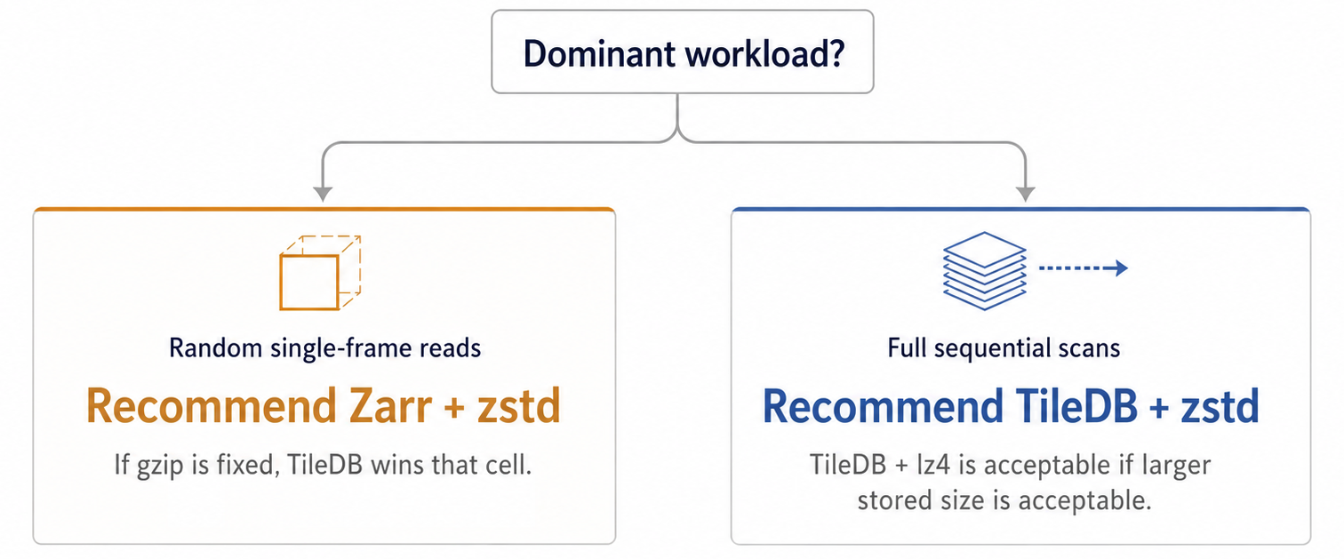
Decision guide: choose for the dominant workload
Bounded by one dataset, one client, one AWS region, and one tested implementation.
14
Notes:
Length 1:20 Finish by 20:20
Decision principle: - The decision starts with the dominant workload. - Is the system mainly latency-first or full sequential scan focused? Random single-frame reads: - For random single-frame reads, recommend Zarr + Zstandard. - It has the best overall slice result. - If gzip is fixed, TileDB wins that cell. - If tail latency matters, be careful with Zarr + lz4. Full sequential scans: - For full sequential scans, recommend TileDB + Zstandard. - This had the best scan time. - It also keeps the stored footprint compact. - TileDB + lz4 is good but only if larger stored size is acceptable. Boundary: - This is bounded by: - one dataset, - one client, - one AWS region, - one tested implementation set. - It is a decision guide for this tested setting. - It is not a universal law. Transition: - I will close with the contribution, limits, and relevance.

Slide 15
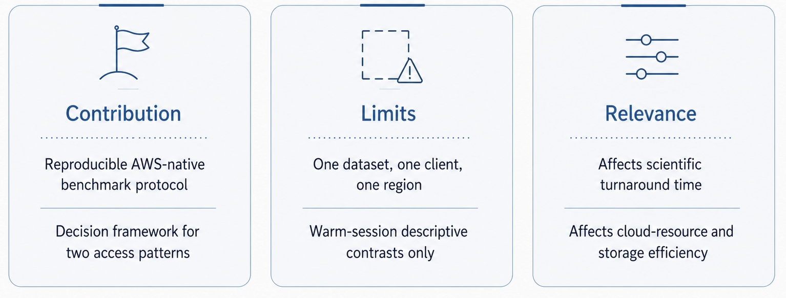
Contribution, limits, and relevance
15
Notes:
Length 1:20 Finish by 21:40
Contribution: - The first contribution is a reproducible AWS-native benchmark protocol. - The second contribution is a decision framework for two access patterns. - The third contribution is the mechanism explanation: - layout, - request intensity, - stored size, - decode behavior
all matter. Limits: - The limits are deliberate. - One dataset. - One client. - One AWS region. - No multi-client contention. - No cross-cloud comparison. - No on-prem Lustre or GPFS baseline. Relevance: - This matters because storage choice affects scientific turnaround time. - Fast random reads support interactive inspection. - Fast scans support reconstruction and reprocessing. - Stored size and request intensity also affect cloud-resource efficiency. Boundary: - The results are useful because they are bounded and reproducible. - They should not be overstated beyond the tested AWS/S3 setup. Transition: - The final takeaway is the decision rule.

Slide 16
Final takeaway: the best storage choice depends on access pattern
Remember one decision rule
Random single-frame reads: Zarr + zstd
Full sequential scans: TileDB + zstd/lz4
Bounded to the tested AWS/S3 setup.
16
Notes:
Length 0:50 Finish by 22:30
Final principle: - The best storage choice depends on access pattern. Random single-frame reads: - For random single-frame reads: - Zarr + Zstandard. Full sequential scans: - For full sequential scans: - TileDB + Zstandard as the default. - TileDB + lz4 is the trade-off option if larger storage is acceptable. Bound the conclusion: - This is bounded to the tested AWS/S3 setup. - I am not claiming a universal format ranking.
Closing sentence: - The main contribution is a controlled benchmark and decision matrix showing that layout and codec must be chosen based on the access pattern.
Backup:
- The thesis is intentionally bounded.
- I do not claim this is universal across all datasets, all clouds, or all clients.
- But the method is reusable:
- fix the dataset,
- define the access patterns,
- measure GM and p95,
- measure request intensity and stored size,
- then choose based on the dominant workload.
- That is the contribution beyond the specific result numbers.

